Slide 1
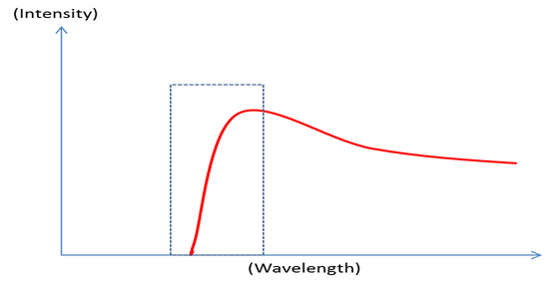
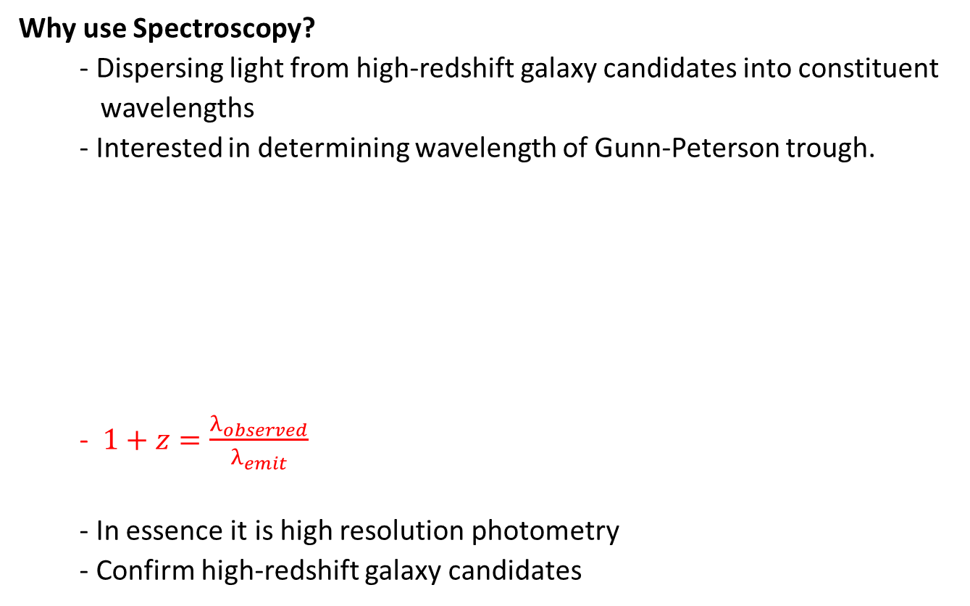
Spectroscopy
Why use Spectroscopy?
- Dispersing light from high-redshift galaxy candidates into constituent
wavelengths
- Interested in determining wavelength of Gunn-Peterson trough.
- $1+z=\frac{λ_{observed}}{λ_{emit}}$
- In essence it is high resolution photometry
- Confirm high-redshift galaxy candidates

Slide 2
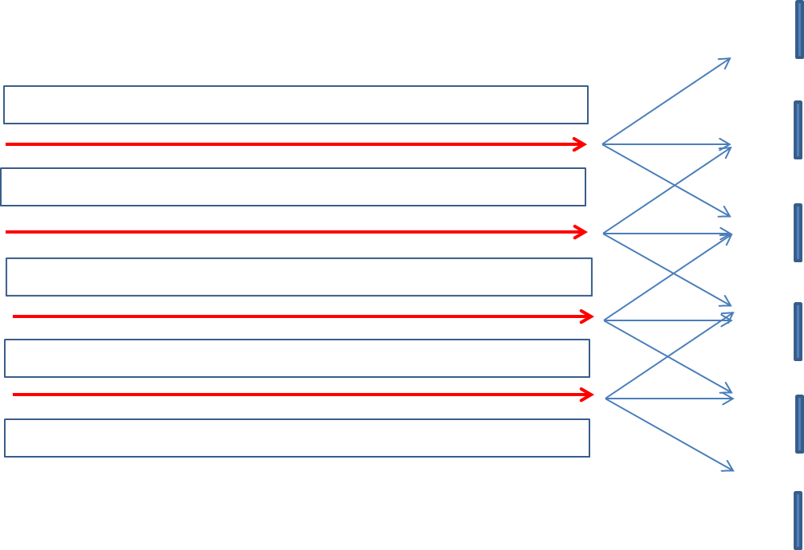

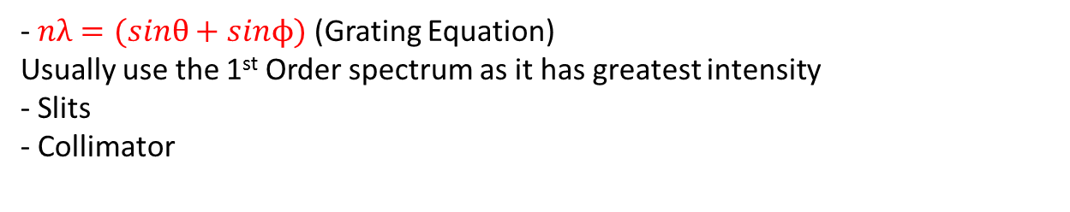
Spectroscopy in Astronomy
- In order to split light there needs to be a dispersive medium, (Prisms or gratings)
2nd Order
1st Order
Zeroth Order
- $nλ=(sinθ+sinϕ)$ (Grating Equation)
Usually use the 1st Order spectrum as it has greatest intensity
- Slits
- Collimator

Slide 3
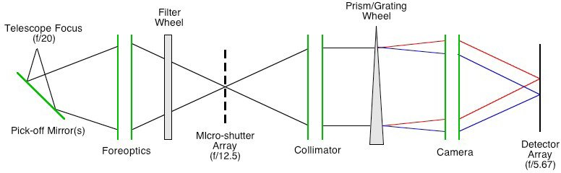
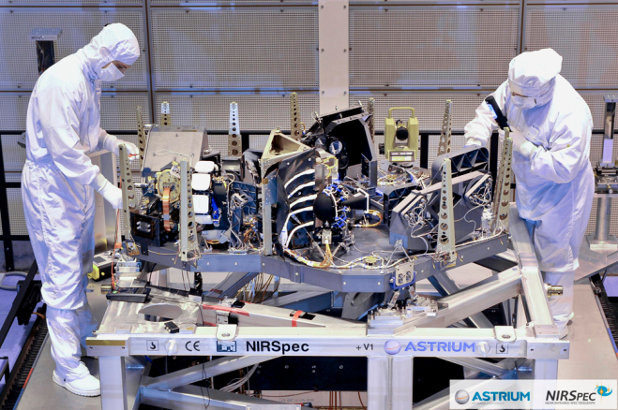
Telescopes considered for use
JWST (James-Webb Space Telescope)
- NIRSpec
- Dispersive media include six gratings and one blazed prism.
- Multi-shutter array enable NIRSpec to obtain 100 different spectra
simultaneously.
- Equipped with an Integral Field Unit in order to obtain spectra of
extended bodies.
- 7 fixed slits covering a wavelength range of 0.6 to 5 microns.

Slide 4
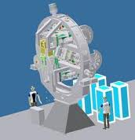
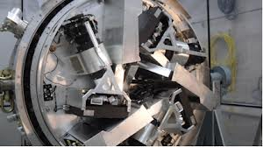
Continued…
E-ELT (European Extremely Large Telescope)
- SIMPLE
- Echelle high-resolution spectrograph.
- Uses 10th to 100th Order Spectrum
- Blazing
- Cross Disperser used to obtain resolution up to 130 000
- HARMONI
- Wide field integral field spectrograph

Slide 5
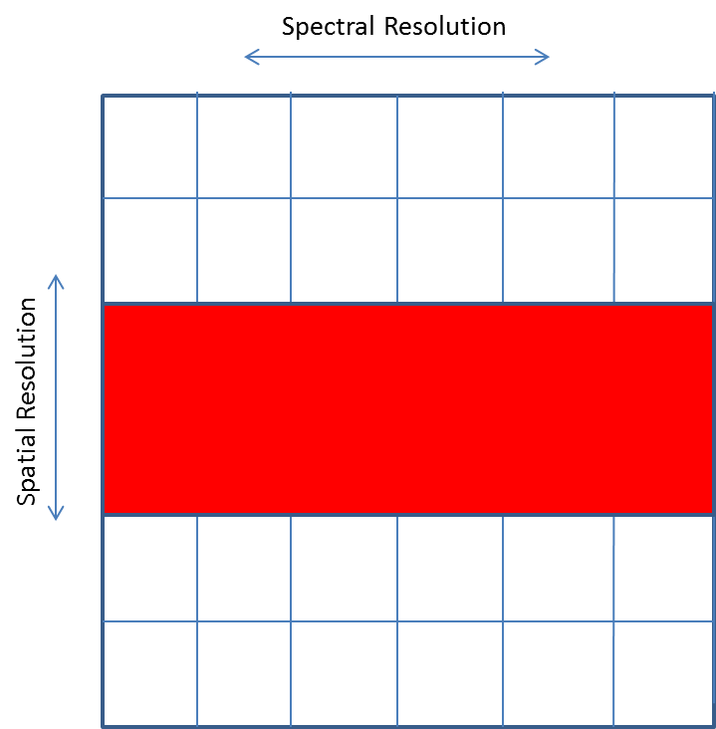

Exposure Times Calculations
$R=\frac{λ}{Δλ}$
$Δλ$ is the spectral resolution element meaning the minimum change in wavelength that can be detected by a spectrograph.
λ is red-shifted wavelength of layman alpha absorption line
Use same S/N calculation as before except values for $N_{Pix}$ and Filter Width will change.

Slide 6

Results
JWST exposure times for Q5 worksheet star ($M_{AB}$ = 28, Z = 9.69)
- Prism
- R=100 Δλ=0.6-5.0 microns
- 2.06 hours
- Grating G140M
- R=1000 Δλ=1.0-1.8 microns
- 71.59 hours
Further Calculations for E-ELT to come

